Slide 1

Acropolis Institute of Technology & Research, Indore
www.acropolis.in

Slide 2


Exploratory
Data Analysis
Submitted to: Department of Information Technology/CSE-DS/CSE-IoT

Slide 3
Team Members
Supervised by: Prof.Varsha Choudhary (IT Department)
.1.Abhishek Pathak
.2.Kashish Sharma .3.Astha Jain
.4.Manjot Singh Nagi
‹#›

Slide 4




Project Presentation Outline
Abstract Introduction Problem Statement
Survey of Existing Systems
Project Objectives Requirement Analysis Solution Proposed
The Outcome Discussion Conclusionsand Limitations
‹#›

Slide 5
Abstract
Exploratory data analysis (EDA) where data interpretations can be done in row and column format. Data need to be analyzed so as to produce good result. Using the result decision can be taken.
We have used python for data analysis. it is object oriented ,interpreted and interactive programming language. it is open source with rich sets of libraries like pandas, MATplotlib etc.
For example recommendation system, ranking of the page, demand fore casting, prediction of purchase of the product .

Slide 6
Introduction
Data analysis and visualization programs allow for reaching even deeper understanding. Data are growing very faster in today’s world. It is not so easy to process the data manually.
Exploratory Data Analysis (EDA) is an approach to summarize the data by taking their main characteristics and visualize it with proper representations. EDA quickly describes the data sets number of rows/columns, missing data, data types and preview.
‹#›

Slide 7

The Problem Statement
Explore FMCG sales data to uncover trends, consumer preferences, and areas for improvement, providing actionable insights for optimizing sales, inventory management, and marketing strategies.

Slide 8
Survey of Existing Systems
Market Basket Analysis for Retail Chains: This project focuses on analyzing transactional data from retail chains to identify patterns in customer purchasing behavior. By understanding which products are frequently bought together.
Sales Forecasting for FMCG Companies: This project involves building predictive models using historical sales data to forecast future demand for FMCG products. By leveraging time-series analysis and machine learning algorithms, the project helps FMCG companies optimize production planning, inventory management, and supply chain operations.
‹#›

Slide 9
Promotion Effectiveness Analysis: This project evaluates the impact of promotional activities on sales performance for FMCG products. By analyzing promotional campaigns, discounts, and marketing strategies, the project helps FMCG companies measure ROI, optimize promotional spend, and maximize sales uplift.
Brand Sentiment Analysis on Social Media: This project involves analyzing social media data to understand consumer perceptions and sentiments toward FMCG brands.

Slide 10
Objectives
Maximizing insights into a data set: Examining the general characteristics of the dataset, such as size, format, and data types.Calculating basic descriptive statistics like mean, median, mode, standard deviation, etc., to understand the central tendency and spread of the data.
Mapping out underlying structure of the data:Performing exploratory data analysis (EDA) techniques to uncover any underlying structures or patterns in the data.

Slide 11
Identifying useful variables: Assess the relevance and significance of each variable in relation to the problem or question we’re trying to address.Using correlation analysis to identify relationships between variables and determine which variables are most closely related to the outcome of interest.
Detecting outliers and anomalies: Visualizing the data using box plots, scatter plots, or density plots to identify observations that deviate significantly from the rest of the data.
Testing a hypothesis: Formulating a clear hypothesis based on your understanding of the data and the problem domain.

Slide 12
Requirement Analysis
Functional Specifications
Non-Functional Specifications
User Authentication
Data Import and Loading
Data Exploration
Data Cleaning
Visualization Tools
Statistical Analysis
Documentation
Help Resources
Performance
Usability
Reliability
Scalability
Security
Maintainability
Compatibility
‹#›

Slide 13
FUNCTIONAL REQUIREMENTS
SOFTWARE | HARDWARE
Development : Jupyter notebook Python3 Pandas, Numpy, Matplotlib Power – BI-2 MS-Excel | SYSTEM : Intel/Pentium/ Processor RAM STORAGE : Hard Disk/SSD (min. 128GB)

Slide 14









DEVELOPMENT TOOLS

Slide 15
SOLUTION PROPOSED
The proposed solution involves conducting exploratory data analysis using Python programming, leveraging libraries like pandas and Numpy, and Power BI and MS Excel for visual insights and detailed analysis, respectively.
By combining these tools and techniques, we can gain deeper insights into their datasets and make informed decisions based on the findings.
‹#›

Slide 16
Python's versatility and ease of use, enabled us to explore complex datasets effectively.
Power BI and MS Excel offer additional functionalities for creating interactive visualizations and performing in-depth analyses, providing us with comprehensive tools to extract meaningful insights from given data.

Slide 17
The Outcome DiscussioN
Monthwise number of quantities sold
Category wise Qty sold
Sub-channel wise total sales
Highest sale in which month
Highest selling product (based on sales)
List of different products company is offering

Slide 18

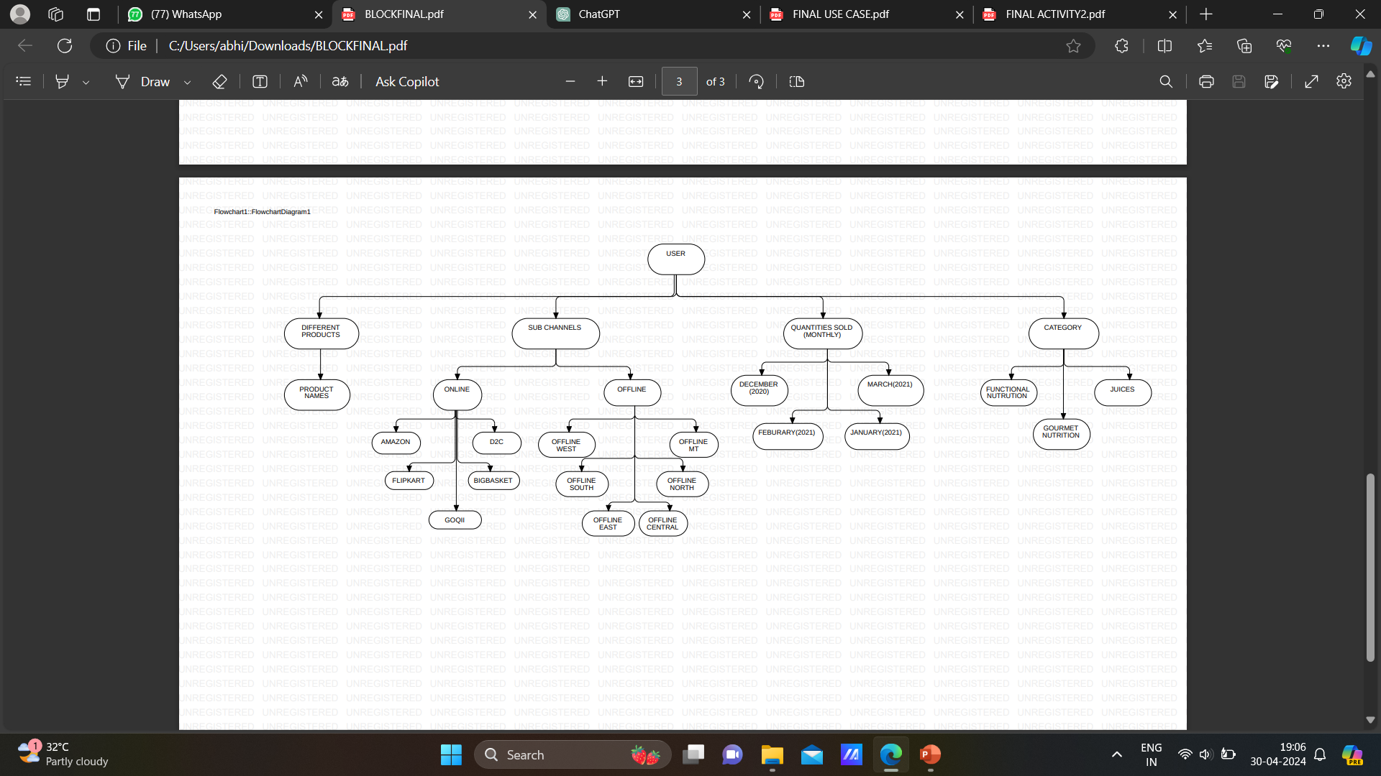
BLOCK DIAGRAM

Slide 19
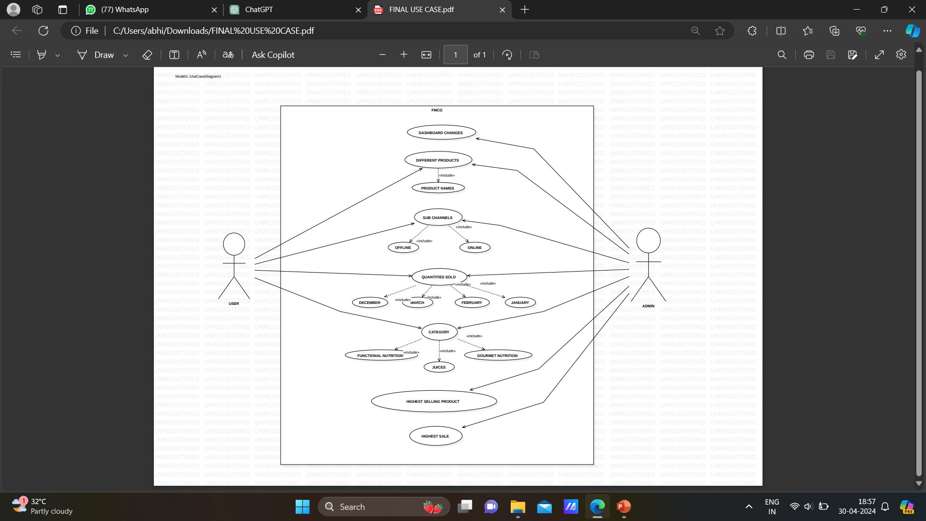
Use - case Diagram

Slide 20
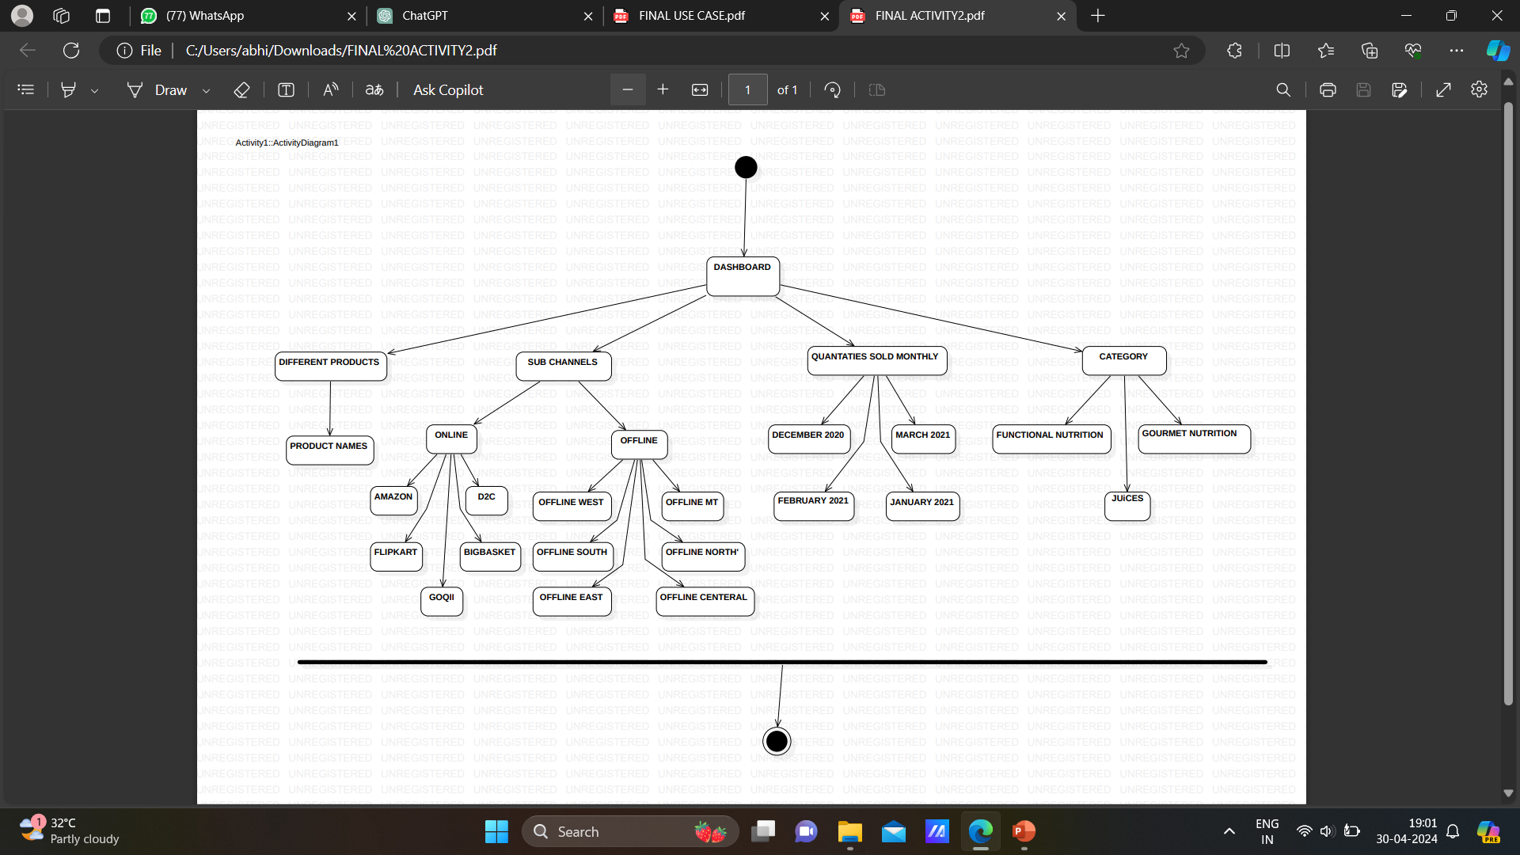
Activity Diagram

Slide 21
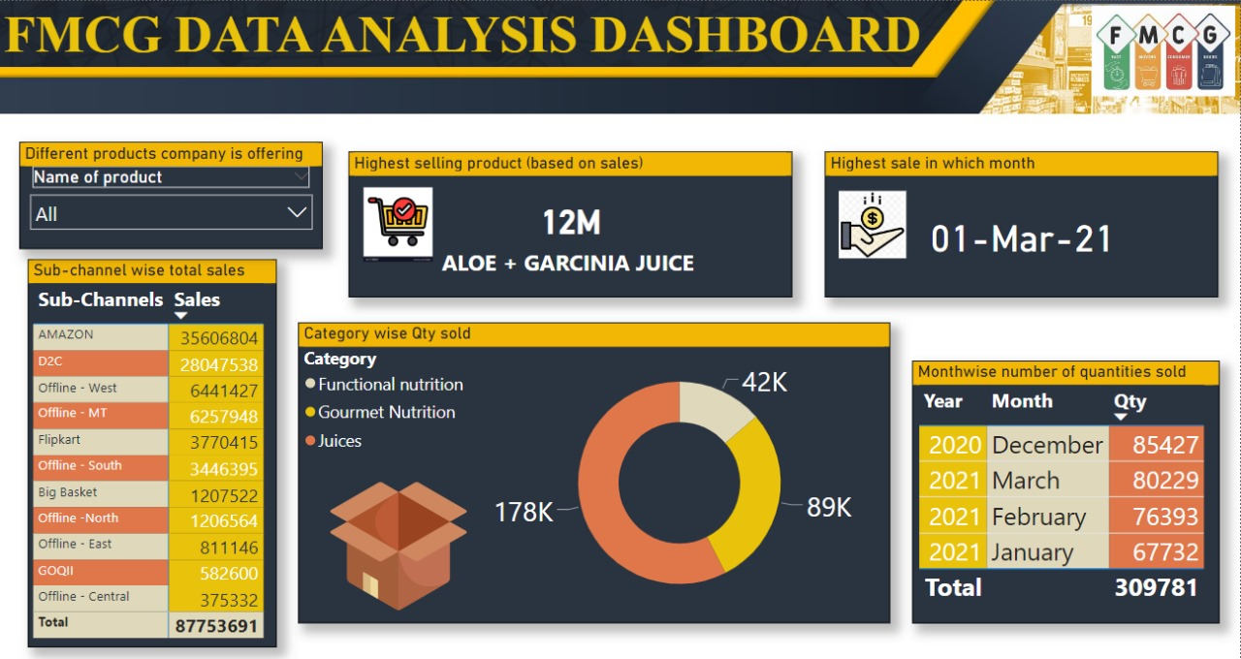
Interface

Slide 22
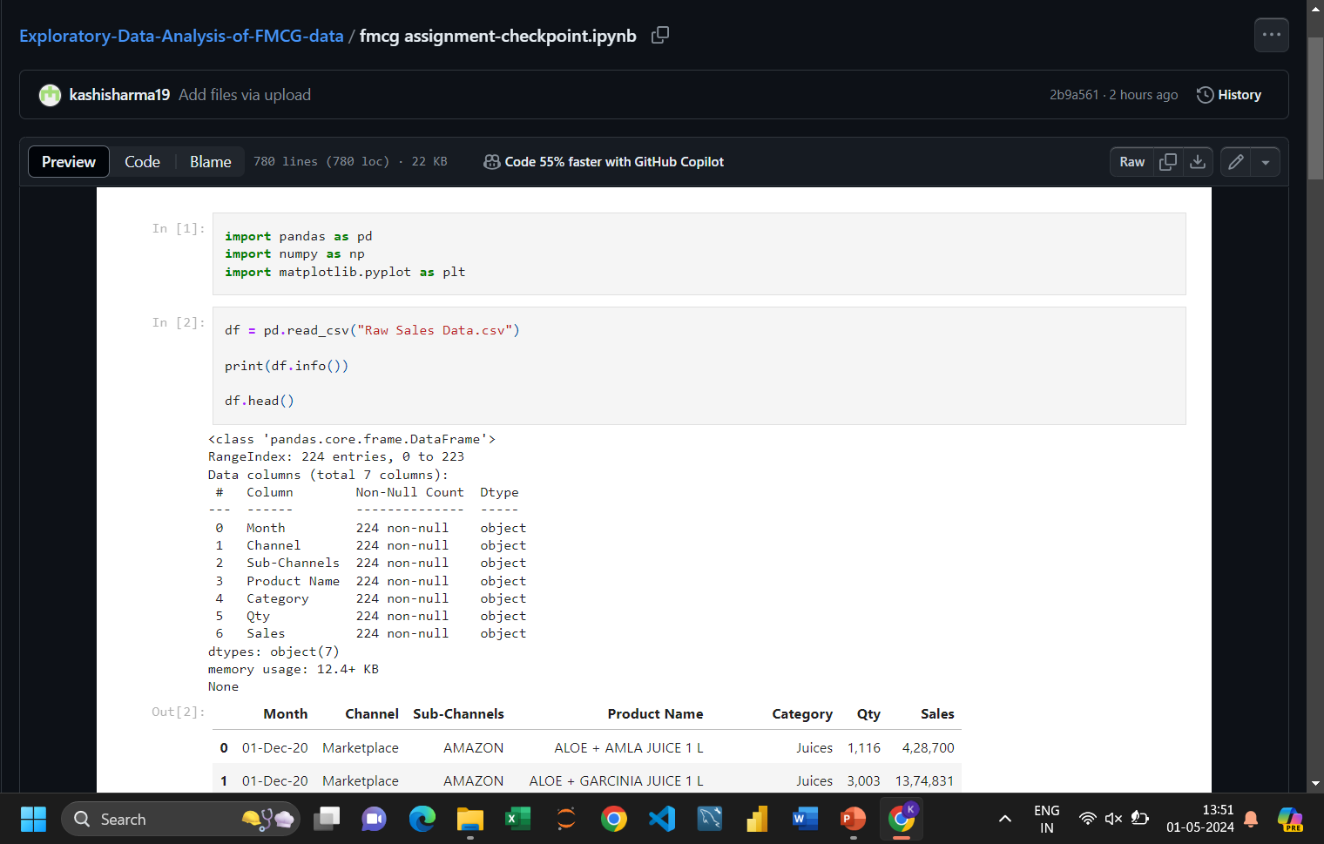

Slide 23
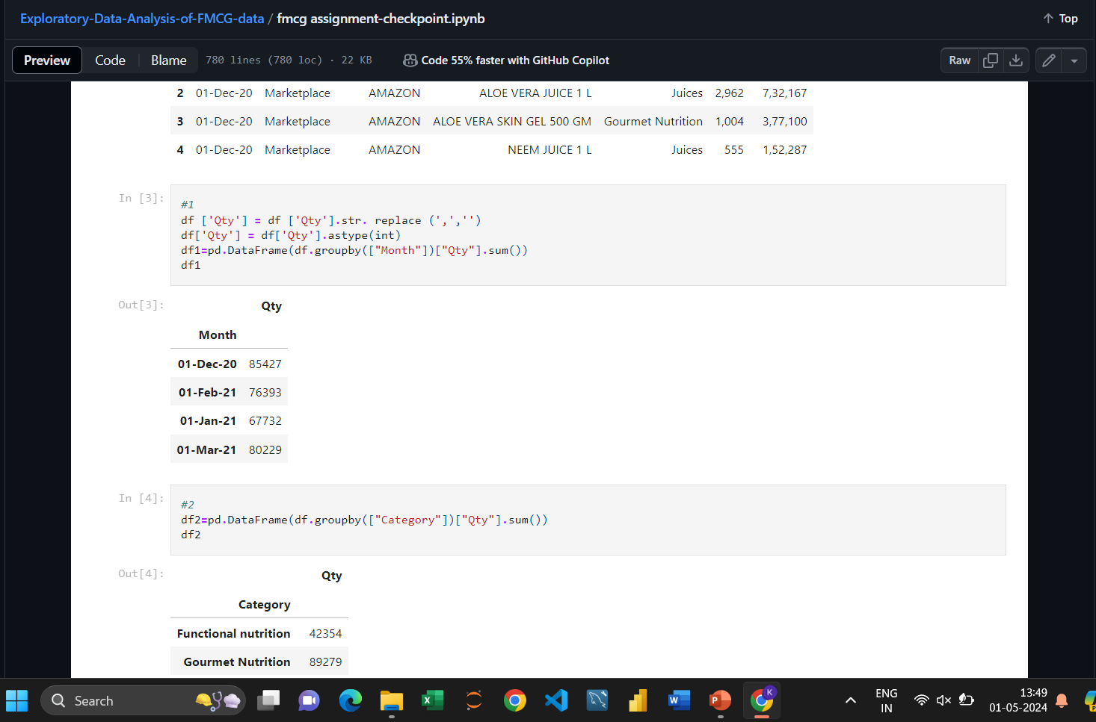

Slide 24
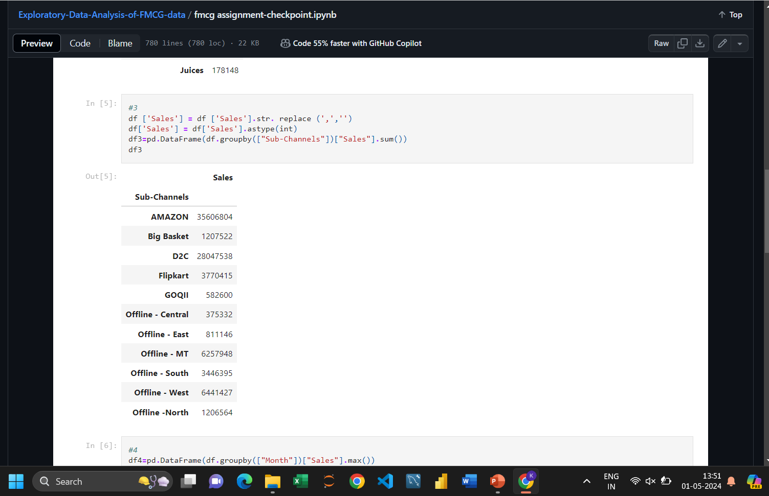

Slide 25
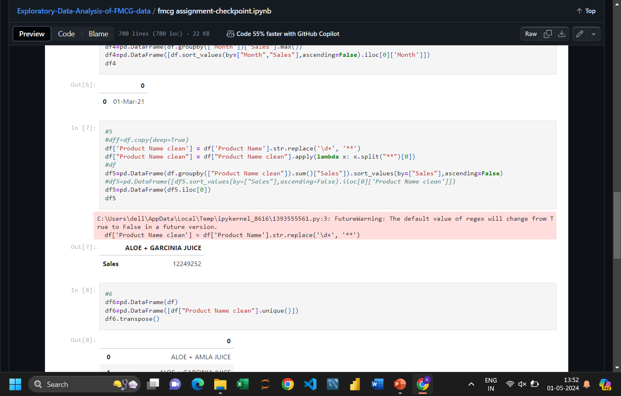

Slide 26
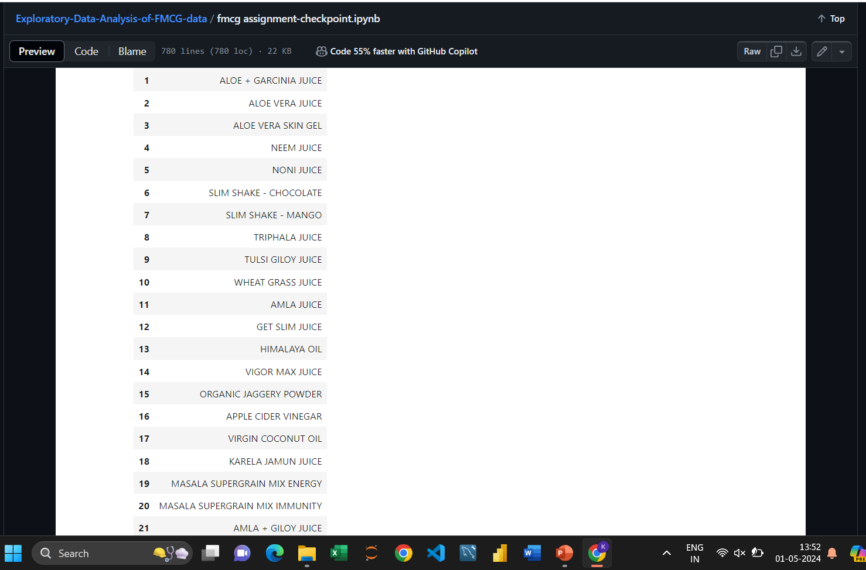

Slide 27
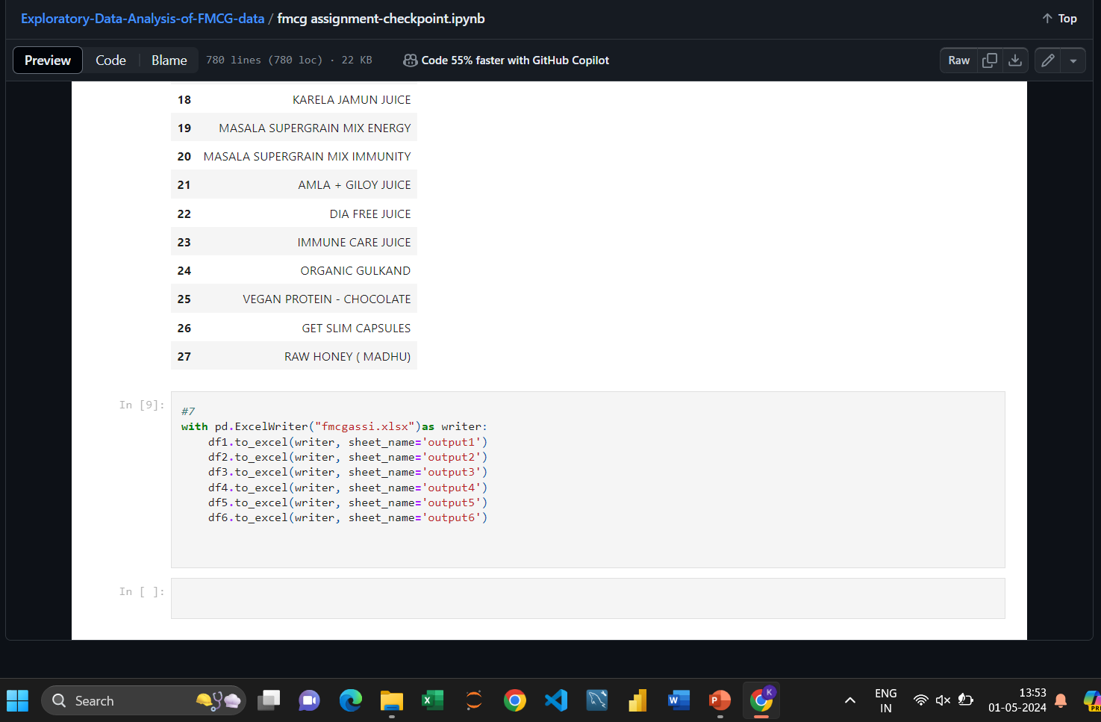

Slide 28
Conclusion and Limitation
Exploratory Data Analysis (EDA) serves as a crucial initial step in the data analysis process, offering valuable insights into the structure, patterns, and relationships within a dataset
EDA can help identify data quality issues, outliers, and potential biases, allowing for data cleaning and preprocessing before proceeding to more advanced analyses.
‹#›

Slide 29
Data Quality Issues: EDA relies on the assumption that the data is accurate, complete, and representative of the population. However, real-world data often contains errors, missing values, and biases, which can affect the validity of the analysis.
Limited Scope: EDA provides a descriptive analysis of the data but may not uncover deeper insights or predictive models. Additional analyses, such as inferential statistics or machine learning, may be necessary to achieve specific objectives.

Slide 30
Acknowledgment
You're welcome! If you have any more questions or need further assistance, feel free to ask. Good luck with your endeavors with Exploratory Data Analysis , and if you ever need guidance or information in the future, don't hesitate to reach out
‹#›

Slide 31
‹#›

Slide 32
‹#›

